Slide 1

Visual Analytics on Credit Cards Default
Maria Ludovica Costagliola
Emanuele De Santis

Slide 2
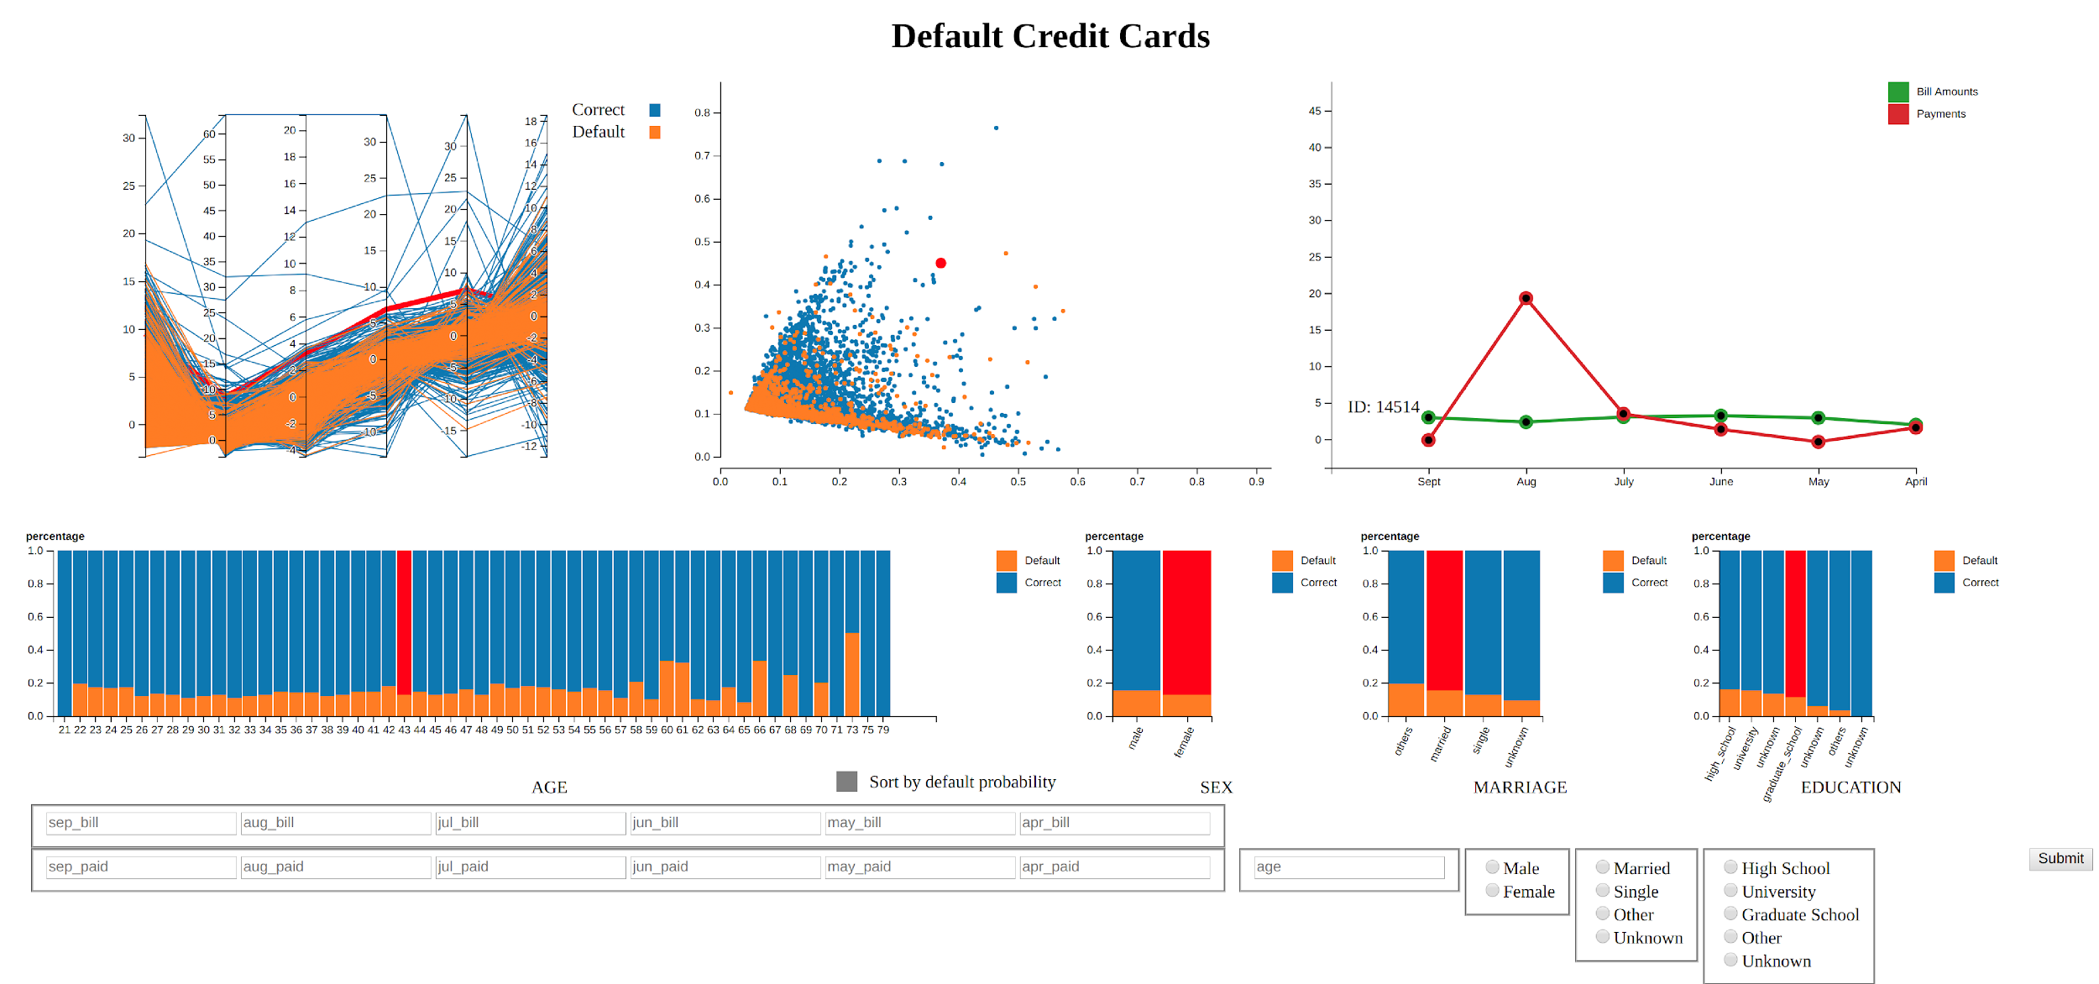
Introduction
Similar topic wrt the paper presented during the lectures
Initial problem to find a suitable dataset on bank transactions due to users’ privacy
Dataset from the same field, but on credit cards default customers (UCI database)
We combine Visualization with Machine Learning techniques (Analytics)

Slide 3
Usage Scenario
Bank director that wants to know how his customers behave
If he has to issue a new credit card he has to know if the customer is “safe” or he can be default
The bank director can grasp these information from machine learning techniques we implemented
With the visualization we have developed, he can see them also without any machine learning algorithm

Slide 4
Dataset
30000 tuples, 24 attributes (some of them are categorical) in the original dataset
Preprocessing gives us 15337 tuples and 19 attributes (AS index: 291403)
ID, Age, Sex, Marital status, Education, Bill Statements (from Apr 2005 to Sept 2005), Payments (same period) and classification
We use categorical attributes for frequency distributions

Slide 5
Interface
7 coordinated views: scatterplot, parallel coordinates, linechart, 4 stacked barcharts + an HTML form
Events fired from user’s interaction with them
Adding a new customer will lead to an update of all views
Recommended screen resolution: 1920x1080 or higher (for a better user experience)
Minimum screen resolution required: 1024x768

Slide 6
Scatterplot
Represents the first two components computed by PCA
The color encodes the classification of each customer (orange for default, blue for correct)
A 2D scatterplot allows the user to quickly identify clusters, in particular clusters of default customers
Two event handlers: mouseover over a point will enlarge it, click on a point will highlight it together with some other information

Slide 7
Parallel Coordinates
6-axis to represent the first 6 PCA components. It is useful to show relations between customers
Same color encoding used in the scatterplot
Each line represents a customer, it can be clicked to show other information about the customer
Axis can be moved to exchange the order

Slide 8
Linechart
Encodes temporal related data of a single customer:
Green line represents Bill Statements over the fixed period of time
Red line represents Payments over the same period
We use normalized values since are not of the same order or magnitude
Original ones are displayed through a mouseover event

Slide 9
Stacked Barcharts
One for each categorical attribute (Age, Sex, Marital status, Education)
Two sub-columns in each column to see at the same time frequency distributions of both correct and default customers
Ordered by decreasing default probability
Click on a sub-column to highlight all points in the scatterplot and all lines in the parallel coordinates related to that sub-bar
Age Stacked Barchart can be ordered also by increasing age

Slide 10
New Data Form
It is an HTML form used to insert new instances in the dataset
It is linked to a python module using AJAX
A Machine Learning algorithm predicts the classification of this new customer
It returns the ID of the newly added customer to the HTML page

Slide 11
Analytics
We had to set up a python web server (using Flask) running locally
At startup it trains an SVM classifier with the original instances (it is possible also to make a 3-fold cross validation)
At the end it launches the web server, so it is possible to access our tool through a web browser
The server listens for requests from http://localhost:5000/getValues

Slide 12
Analytics cont’d
Clicking on Submit button in the interface, jQuery sends an HTTP POST message to http://localhost:5000/getValues containing all values from the form as a JSON string
The python module reads this string and computes the vector to be passed to the SVM classifier
It classifies the new instances and writes it in dataset.csv
All remaining csv files are recomputed taking into account the new customer added
The module returns the ID and reloads the HTML page
In this way the newly added customer will be highlighted in the scatterplot

Slide 13
Conclusion
This tool can be useful in a financial institution for a bank director
This tool combines both machine learning and visual analytics techniques
The bank director can easily use the machine learning classifier to classify new instances, but it can also easily rely on visual comparisons to classify a new instance
The visualization is a bit crowded and glitchy due to the high number of tuples, that is instead a good thing for SVM training

